Slide 1
Regression with Time-Series Data:
Nonstationary Variables
Part 2
BUAN / MECO 6312
Dr. Moran Blueshtein
University of Texas - Dallas

Slide 2
Spurious Regressions

Slide 3
Spurious Regressions
It is important to know whether a time series is stationary or non-stationary.
When nonstationary series are used in regression analysis there is a danger of obtaining apparently significant regression results from unrelated data.
Such regressions are said to be spurious

Slide 4
Spurious Regressions
Consider two independent random walks:
These series were generated independently and, in truth, have no relation to one another.

Slide 5
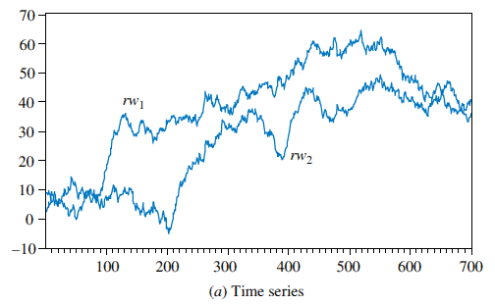
Spurious Regressions
Time series and scatter plot of two random walk variables
Yet when plotted, we see a positive relationship between them!

Slide 6
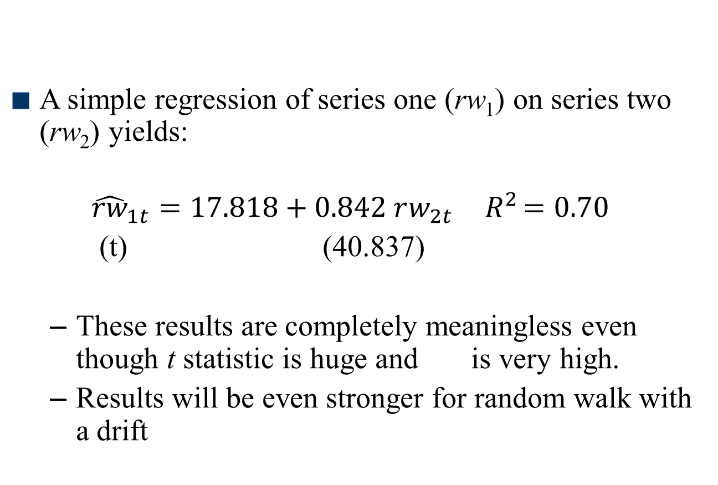
Spurious Regressions
A simple regression of series one (rw₁) on series two (rw₂) yields:
$${\hat{rw}}_{1t}=17.818+0.842 rw_{2t}{ R}^{2}=0.70$$
(t) (40.837)
These results are completely meaningless even though t statistic is huge and is very high.
Results will be even stronger for random walk with a drift

Slide 7
Spurious Regressions
Since many macroeconomic time series are nonstationary, it is particularly important to take care when estimating regressions with macroeconomic variables
Notes:
When nonstationary time series are used in a regression model, the results may spuriously indicate a significant relationship when there is none.

Slide 8
Unit Root Tests for Stationarity

Slide 9
Unit Root Tests for Stationarity
Dickey – Fuller Unit Root Tests for Stationarity
Dickey-Fuller Test 1 (No constant and No Trend)
Consider the AR(1) model:
We can test for nonstationarity by testing the null hypothesis that ρ = 1 against the alternative that ρ < 1
Notes:
AR (1) model is a model with no constant and no trend.

Slide 10
Unit Root Tests for Stationarity
Dickey-Fuller Test 1 (No constant and No Trend)
A more convenient form is:
The hypotheses are:

Slide 11
Unit Root Tests for Stationarity
Dickey-Fuller Test 2 (With Constant but No Trend)
The second Dickey–Fuller test includes a constant term in the test equation:
The null and alternative hypotheses are the same as before

Slide 12
Unit Root Tests for Stationarity
Dickey-Fuller Test 3 (With Constant and With Trend)
The third Dickey–Fuller test includes a constant and a trend in the test equation:
The null and alternative hypotheses are as before:
H₀: γ = 0 and H₁:γ < 0

Slide 13
Unit Root Tests for Stationarity
If we reject the null hypothesis we conclude that the series is stationary.
If we do not reject the null hypothesis, we conclude that the series is not stationary or that the series has a unit root

Slide 14
Unit Root Tests for Stationarity
The Dickey-Fuller Testing Procedures
The Dickey-Fuller testing procedure:
First plot the time series of the variable and select a suitable Dickey-Fuller test based on a visual inspection of the plot
If the series appears to be wandering or fluctuating around a sample average of zero, use test 1
If the series appears to be wandering or fluctuating around a sample average which is nonzero, use test 2.
If the series appears to be wandering or fluctuating around a linear trend, use test 3.

Slide 15
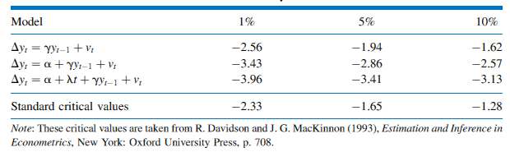
Unit Root Tests for Stationarity
Critical Values for the Dickey–Fuller Test
This t-statistic no longer has the t-distribution under the null hypothesis.
Instead, we use the statistic often called a τ (tau) statistic
Critical values for one tail (left) are given in the following table:

Slide 16
Unit Root Tests for Stationarity
Augmented Dickey–Fuller Test
An important extension of the Dickey-Fuller test allows for the possibility that the error term is auto-correlated.
Such auto-correlation is likely to occur if our earlier models did not have sufficient lags to capture all full dynamic nature in the process.
The solution: we will add lags of the dependent variable until we eliminate auto-correlation in the residuals, and only then we will conduct the Dickey-Fuller test.
This is the augmented Dickey-Fuller test.

Slide 17
Unit Root Tests for Stationarity
The Dickey-Fuller Tests: An Example
As an example, consider the two interest rate series:
The federal funds rate (F_{t})
The three-year bond rate (B_{t})

Slide 18
Unit Root Tests for Stationarity
The Dickey-Fuller Tests: An Example

Slide 19
Regression When There is No Cointegration
First Difference Stationary
Consider the random walk model:
This can be rendered stationary by taking the first difference:
The variable y_{t} is said to be a first difference stationary series

Slide 20
Unit Root Tests for Stationarity
Order of Integration
Series like y_{t}, which can be made stationary by taking the first difference, are also said to be integrated of order one, and denoted as I(1)
Stationary series are said to be integrated of order zero, I(0)
In general, the order of integration of a series is the minimum number of times it must be differenced to make it stationary

Slide 21
Unit Root Tests for Stationarity
Order of Integration
The results of the Dickey–Fuller test for a random walk applied to the first differences are:

Slide 22
Unit Root Tests for Stationarity
Order of Integration
Based on the large negative value of the t statistic (-5.487 < -1.95), we reject the null hypothesis that ΔF_{t} is nonstationary and accept the alternative that it is stationary.
We similarly conclude that ΔB_{t} is stationary
(-7.662 < -1.95)
Conclusion: F and B are both integrated of order 1.

Slide 23
First Difference Stationary
If the series are difference stationary – by taking first differences
Suppose that y and x are I(1), an example of an ARDL(1,1) regression equation is:

